Slide 1


DOMAINDAO.x State Your Name ✖ Stake Your Claim Powered by GhostFire Digital | AI Digital Underground

Slide 2
The Problem
✖ Domains stuck in Web1 — marketplaces are bland gatekeepers
✖ Generational inertia — early .com holders stagnate
✖ Speculation > Utility — culture & innovation ignored
✖ Missed opportunities — no DAO, no AI-native governance

Slide 3


Our Solution
DomainDAO.x = AI-enhanced, DAO-powered identity infrastructure
ChainGPT-powered valuation + classification
Token-gated communities tied to domain NFTs
AI-generated governance proposals
Cross-chain portable identities

Slide 4

Market Opportunity
🌍 $610+ .AI domains (2025)
🏛 $30B+ DAO treasuries
📈 $16T+ tokenized assets by 2030
$22B+ domain market
🤖 $400B+ AI industry (2027)
→ No DAO uniting domain industry yet: massive whitespace

Slide 5
Architecture
Protocol Layer: Smart contracts for NFTs + membership
1
AI Layer: ChainGPT Agents for valuation + proposals
2
Community Layer: Token-gated access + voting
3
Application Layer: Dashboard with AI insights & governance portal
4

Slide 6
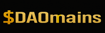
Tokenomics Preview
Governance rights — propose & vote
Stake for gated access + perks
Earn rewards for curation & participation

Slide 7

• Phase 1 (0–3m): MVP testnet, ChainGPT valuation, gated chat • Phase 2 (3-6m): AI proposals, DAO voting, dispute resolution • Phase 3 (6–12m): $DAOmains token launch, cross-chain bundles
Roadmap

Slide 8


Impact & Use Cases
TokenUp.ai
BlockBond.ai
Valulation + Tokenization
Token-gated Utility
Domains as programmable, intelligent governance assets
Curated naming seasons + registry tools
DAO-powered naming games and cultural drops
Bridges AI + Web3 identity

Slide 9
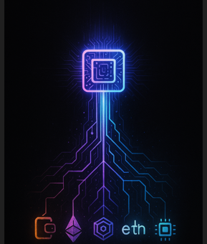
The Ask
Frontend MVP + governance tools
Token-gated pilot launch
Seeking $50K via ChainGPT Builders Program
ChainGPT API integration

Slide 10

Founder & Studio
Founder: Scott Backman (aka Grimy.40oz)
Studio: GhostFire Digital | AI Digital Underground
Slogan: State Your Name ✖ Stake Your Claim
Website: https://ghostfire.ai/domaindao.x.html
Whitepaper: /downloads/Grant-Whitepaper- DomainDAO.x.docx
Contact: Scott@ghostfire.ai | 719-464-4084

